Slide 1
Automated Lip Reading for the Romanian Language
Proposed by Aenășoaei Denis-Claudiu
Scientific coordinator: Lect. Dr. Benchea Răzvan

Slide 2
Contents
Introduction: what is lip-reading and why is it important?
A dataset for Romanian Lip Reading
Implemented model
Experiments and evaluation
Conclusions

Slide 3
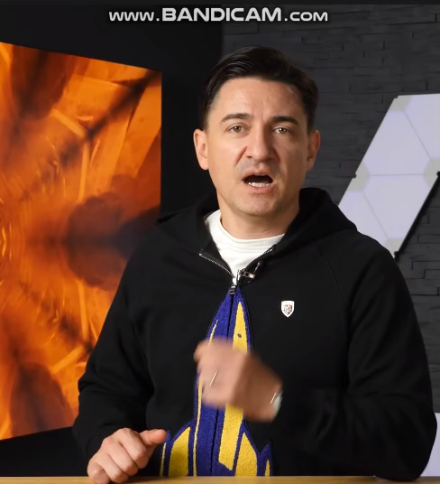

Slide 4
Introduction: what is lip-reading and why is it important?
Lip reading is the ability of understanding speech only by visually interpreting the movement of the lips
It is notoriously hard for human, as they are able to lip read only around 22% of words spoken
It is the only way a person with hearing disabilities could understand vocal speech
The number of hearing-impaired worldwide is around 5.5%
Has applications mostly in medicine and communications

Slide 5
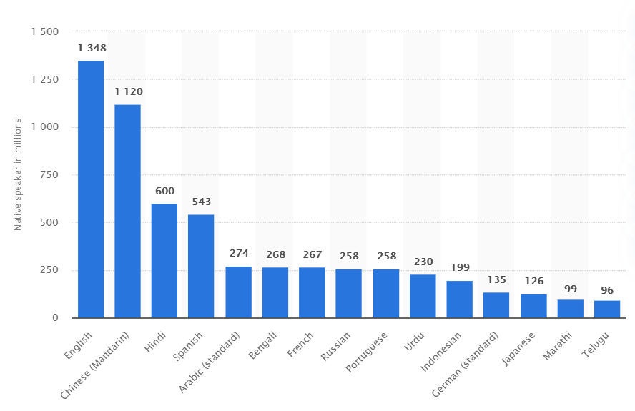
Why in another language?
Even if around 20% of the world’s population speaks English, there is a need to also research into other languages.

Slide 6
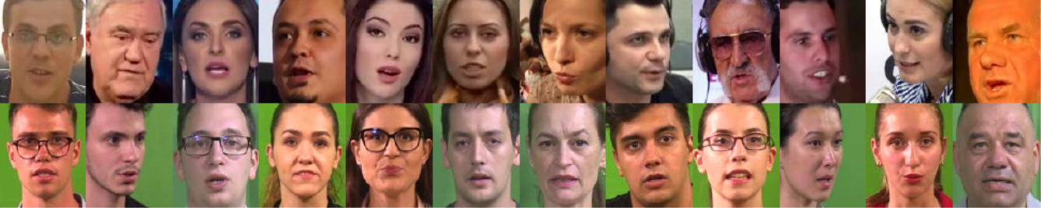
The dataset
Name: Wild LRRo, Lab LRRo
Created by researchers from University of Bucharest in 2019-2020
Includes two separate collections, one with videos from wild environments (above) and one from a laboratory, controlled environment (below)

Slide 7
Wild LRRo dataset
Created in 2019
Contains a total of 1088 videos of 35 different speakers pronouncing a total of 21 words
Videos were downloaded from YouTube, mostly containing data from Romanian TV Shows
The speaker variety is high, with various filming angles and backgrounds, and high amounts of noise

Slide 8
Lab Lrro dataset
Created in 2020
Contains a total of 8170 videos of 19 different speakers pronouncing a total of 48 different words
Videos were created in a laboratory environment with professional audio-video recording equipment, with speakers being mostly young adults attending university
Videos are a lot more consistent, having a lack of background noise

Slide 9
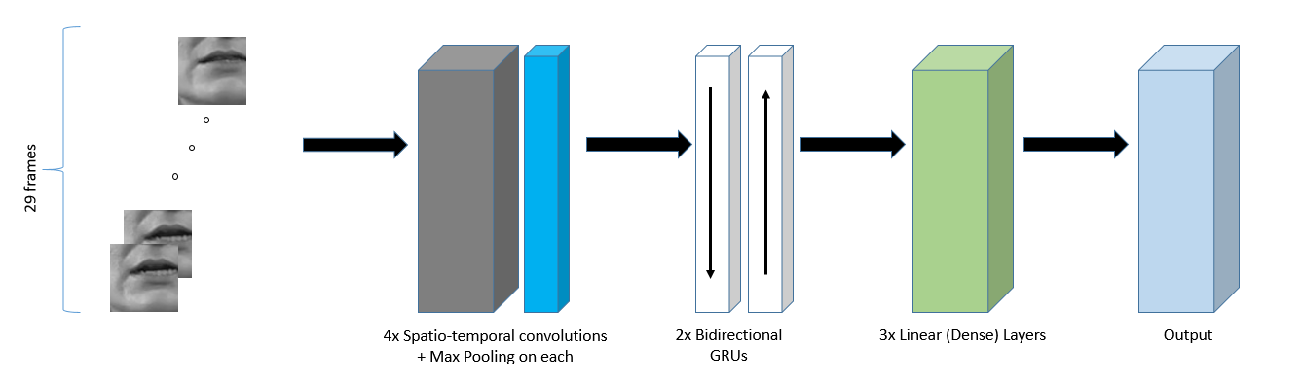
Neural network model
Created in Python, using the Tensorflow Library, with the Keras API

Slide 10
experiments
The model was created and trained in the Google Colaboratory environment, which gives access to free high speed computing power
Two distinct models were created for their respective dataset, with the only difference being the output layer, with it’s size being 21 for the Wild Dataset and 48 for the Lab Dataset
Their results will be compared to the baselines provided by the LRRo team, other models for English and the mean accuracy of human lip readers

Slide 11
Performance evaluation
Will be done using the standards for Automated Lip Reading evaluation, being accuracy, word error rate and character error rate, with the later two computing the percentages of missed words (characters)

Slide 12
Results
Method | Dataset | Dataset Size (for training) | WER | CER | Accuracy
Human lip-reader (avg.) | N/A | N/A | 78% | - | 22%
Papandreou et al (2009) | CUAVE (Lab) | 1800 | 17% | - | 83%
Chung & Zisserman (2016) | BBC TV (Wild) | >400000 | 34.6% | - | 65.4%
LRRo Baselines (Top1) | Wild LRRo | 846 | 67% | - | 33%
Proposed model | Wild LRRo | 968 | 41.9% | 40% | 58.1%
LRRo Baselines (Top1) | Lab LRRo | 6505 | 29% | - | 71%
Proposed model | Lab LRRo | 7365 | 10% | 9% | 90%

Slide 13
Conclusions
Results show a great improvement when we differentiate recordings from a controlled environment from the ones that are found in our everyday lives
If the accuracy of 90% could be preserved for all environments, it could be used in real life situations, helping people in need
Even if accurate, a lip reader capable of reading only words has a limited amount of use cases

Slide 14
Conclusions (ctnd.)
Right now, most research tries to move the problem from a classification one, because of the factorial boom that happens when the number of classes increases
For example, if our lexicon would have 100 words, and we want to predict a sentence of - 2 words, we would have 100 * 99 classes on the output layer - 3 words, we would have 100 * 99 * 98 classes on the output layer and so on.

Slide 15
Conclusions (ctnd.)
ALR has advanced a lot from its pioneering, reaching up to the 97’th percentile in terms of accuracy on the English language
In the Romanian language, with LRRo being the only dataset on it, the presented model has the highest accuracy, as far as I know
Even with a limited vocabulary, there could be some use cases, like short commands that start

Slide 16
Thank you for your attention!
Any Questions?

